Slide 1
Git tracks changes for multiple files by keeping them all in repositories - special directories with some hidden Git machinery.
Rather than saving entire separate versions of each file, Git keeps a record of the changes that have been made to each file - much more space-efficient.
Because Git stores changes, rather than whole files, looking at what's changed from one iteration to the next is very easy.
Git allows you to easily keep track of parallel versions of a project using a feature called branching. We won't cover this feature now, but you'll be using it a lot once you start the course.

Slide 2
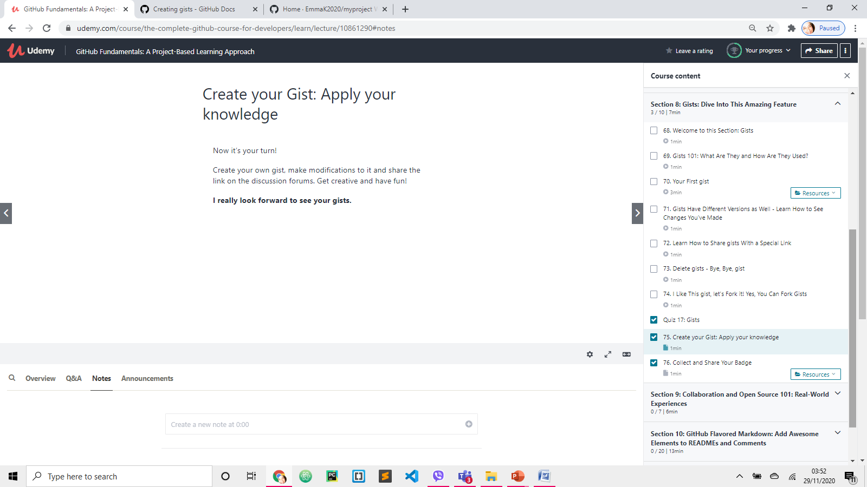
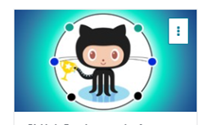
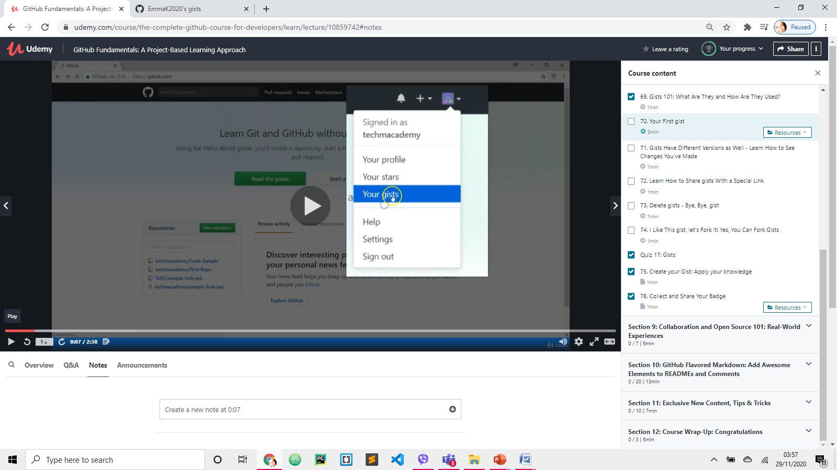
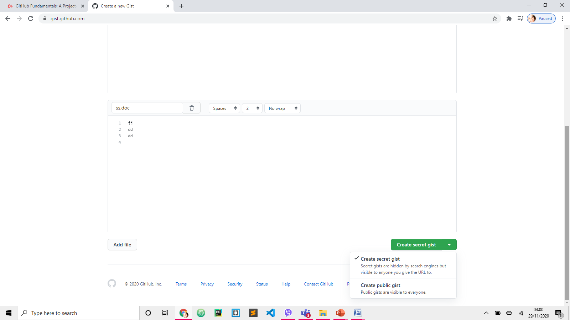
GISTS [dzist]
No folders in GITS
https://docs.github.com/en/free-pro-team@latest/github/writing-on-github/creating-gists
https://gist.github.com/discover example
Description
File name, with extension
Fill in content
ADD FILE (optional)
***You cannot convert GIST from public to secret

Slide 3
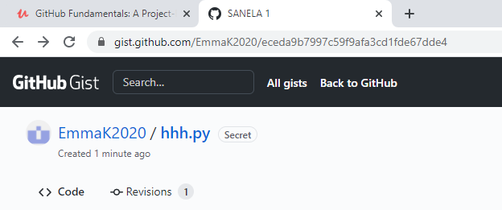
ALL GISTS will show most recent public Gists created by other users

Slide 4
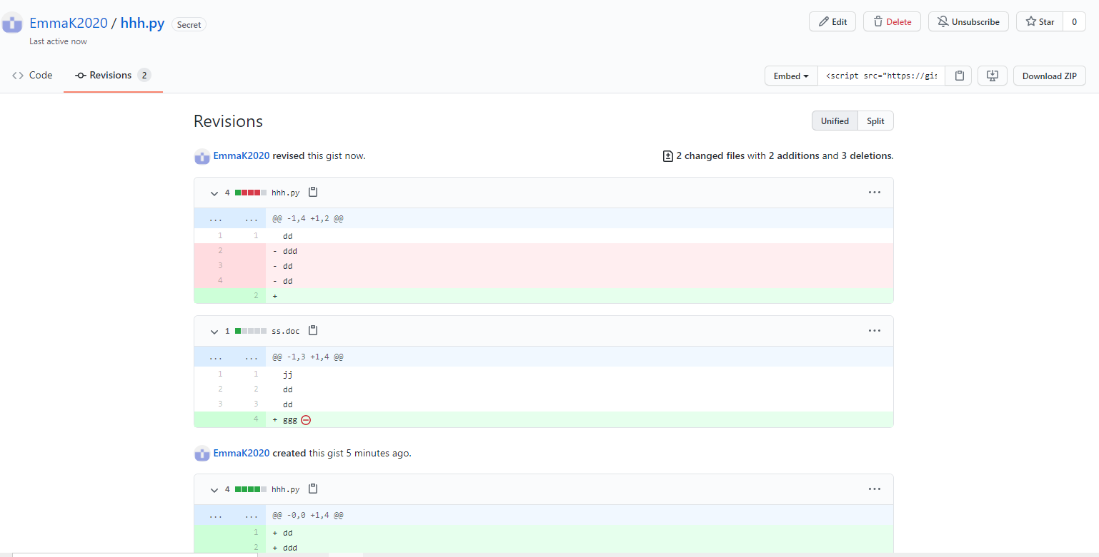
EDIT Gist
Select EDIT to do some changes to your Gist. Save changes. Click REVISIONS to see changes.

Slide 5
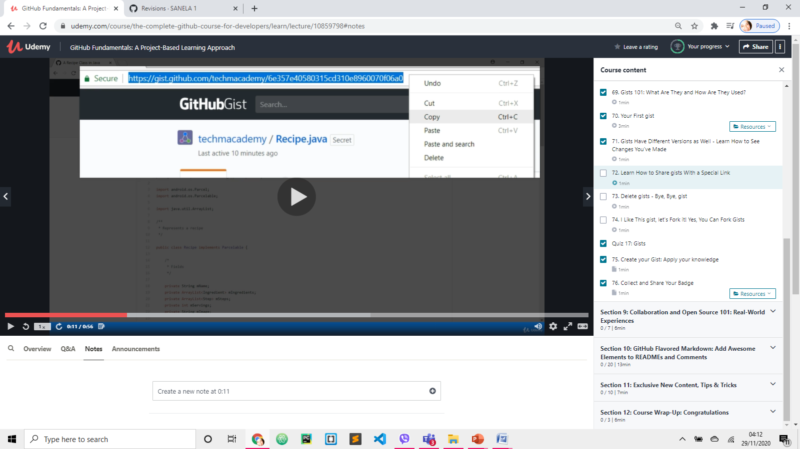
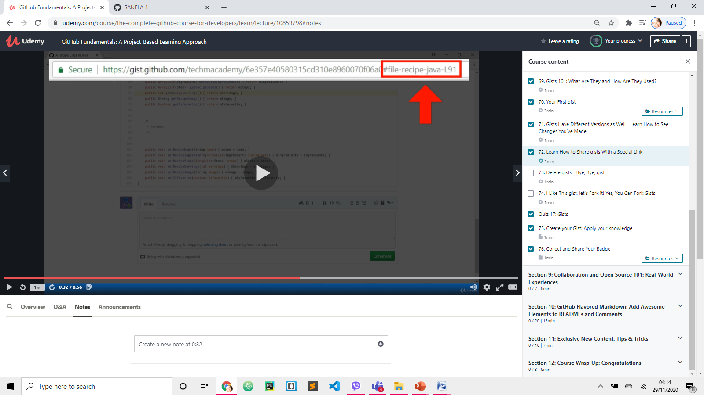
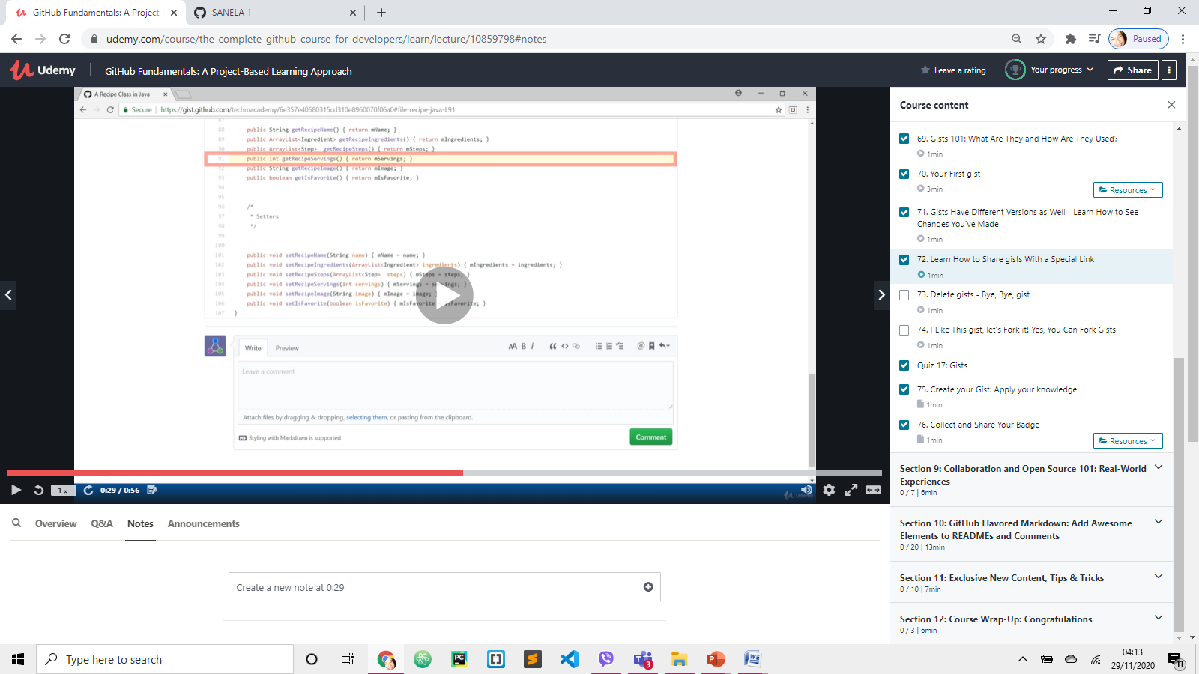
SHARE Gist with a LINK
Click on URL and copy
If you click on a particular line in your code, URL will include that line number.
The link will scroll automatically to the shared line of code.

Slide 6
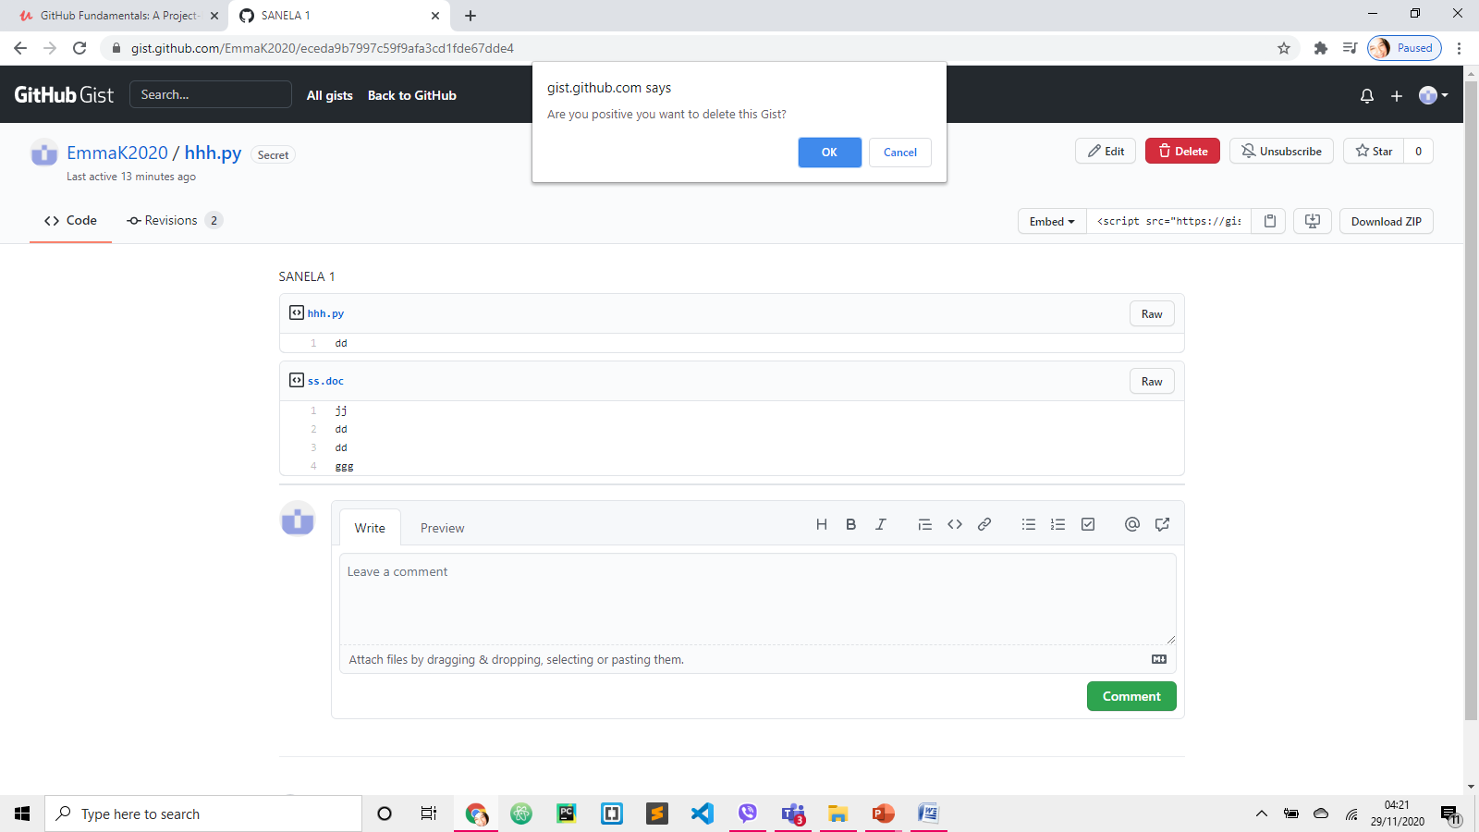
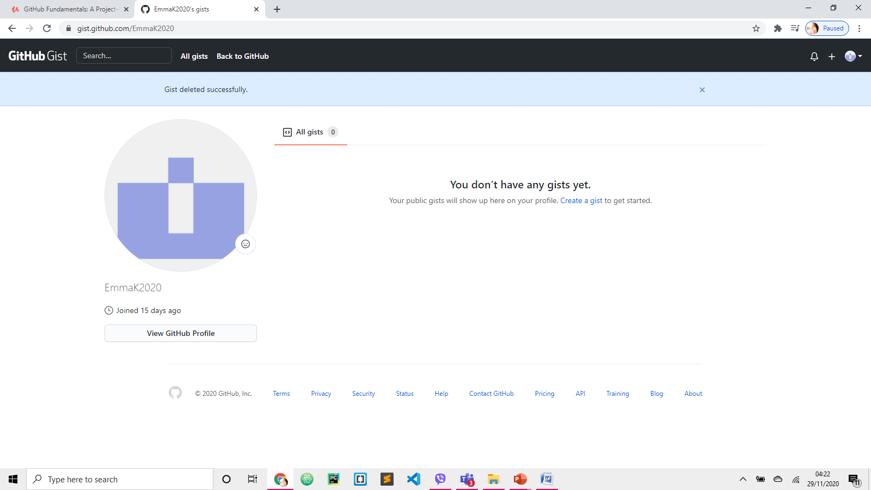
DELETE Gist
2
1
3

Slide 7
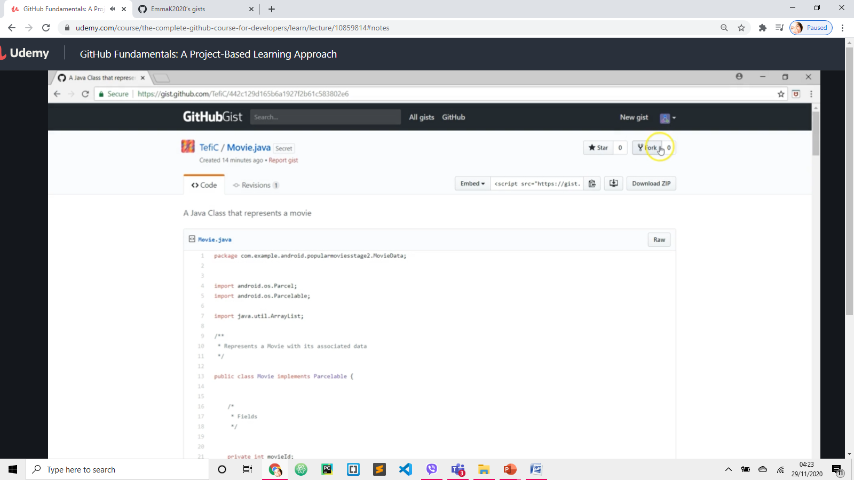
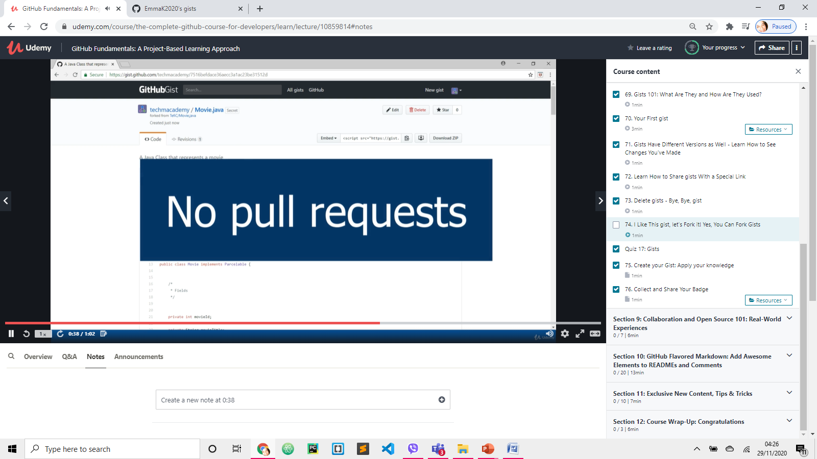
FORK Gist
FORK someone’s Gist by PASTING his Gist’s URL.
Now we have a copy of it in our Gist account that we can modify
UNLIKE repository,
but we can leave a comment on Gist asking the user or owner if he/she would like to in cooperate our changes.

Slide 8
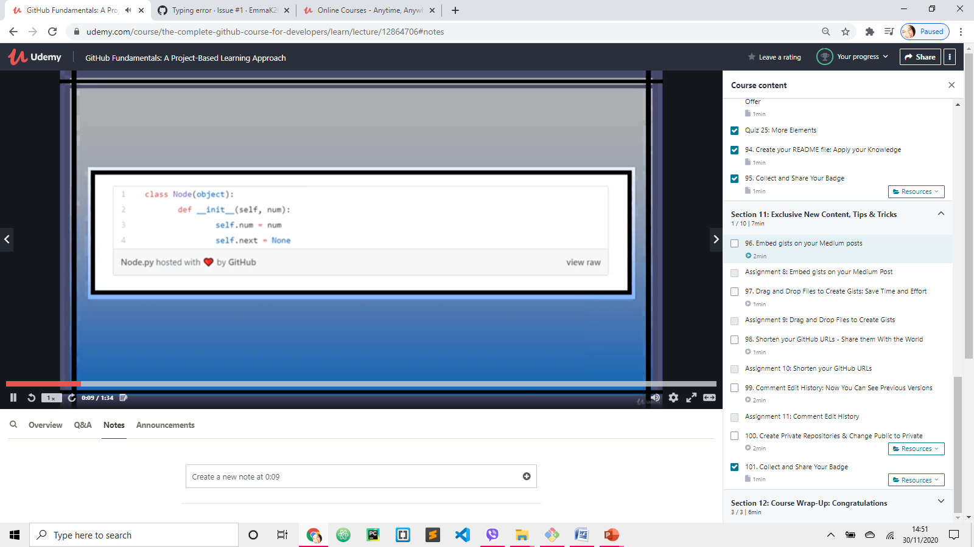
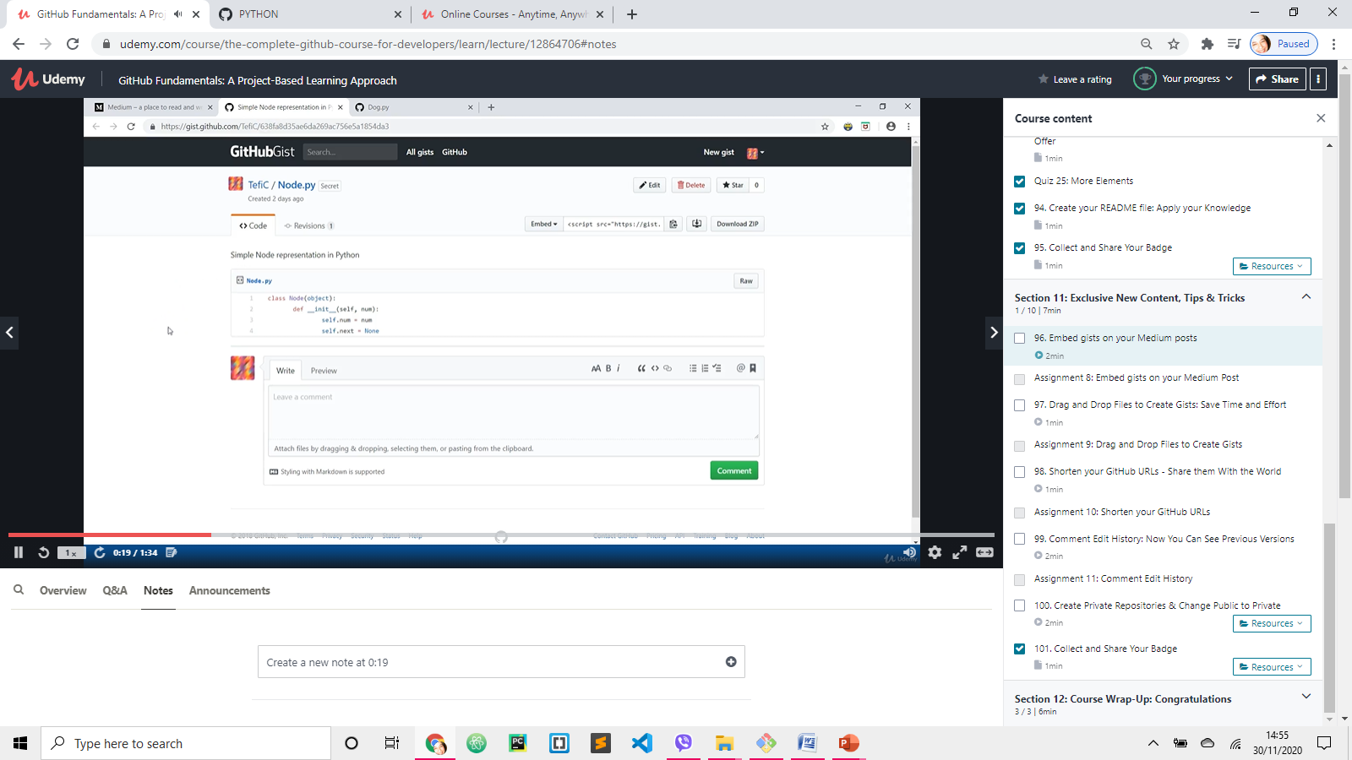
Embed gist on Medium 1
Create GIST
Node.py

Slide 9
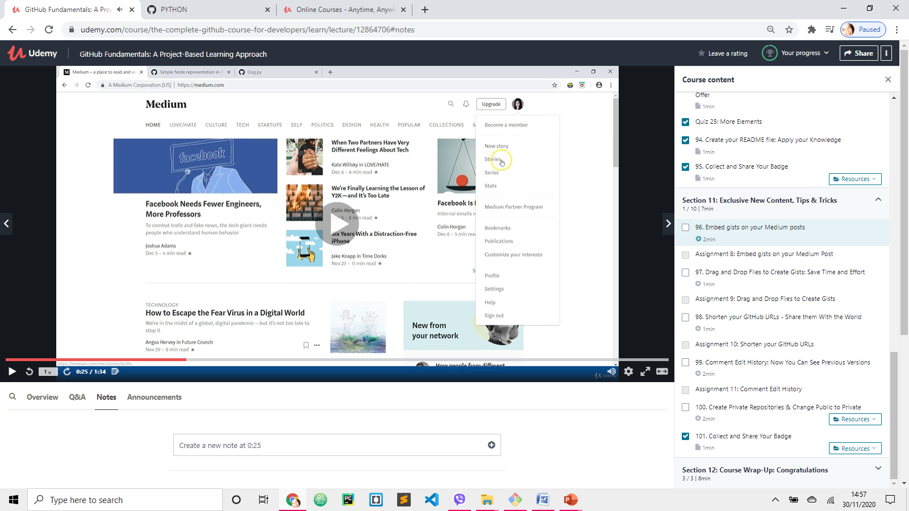
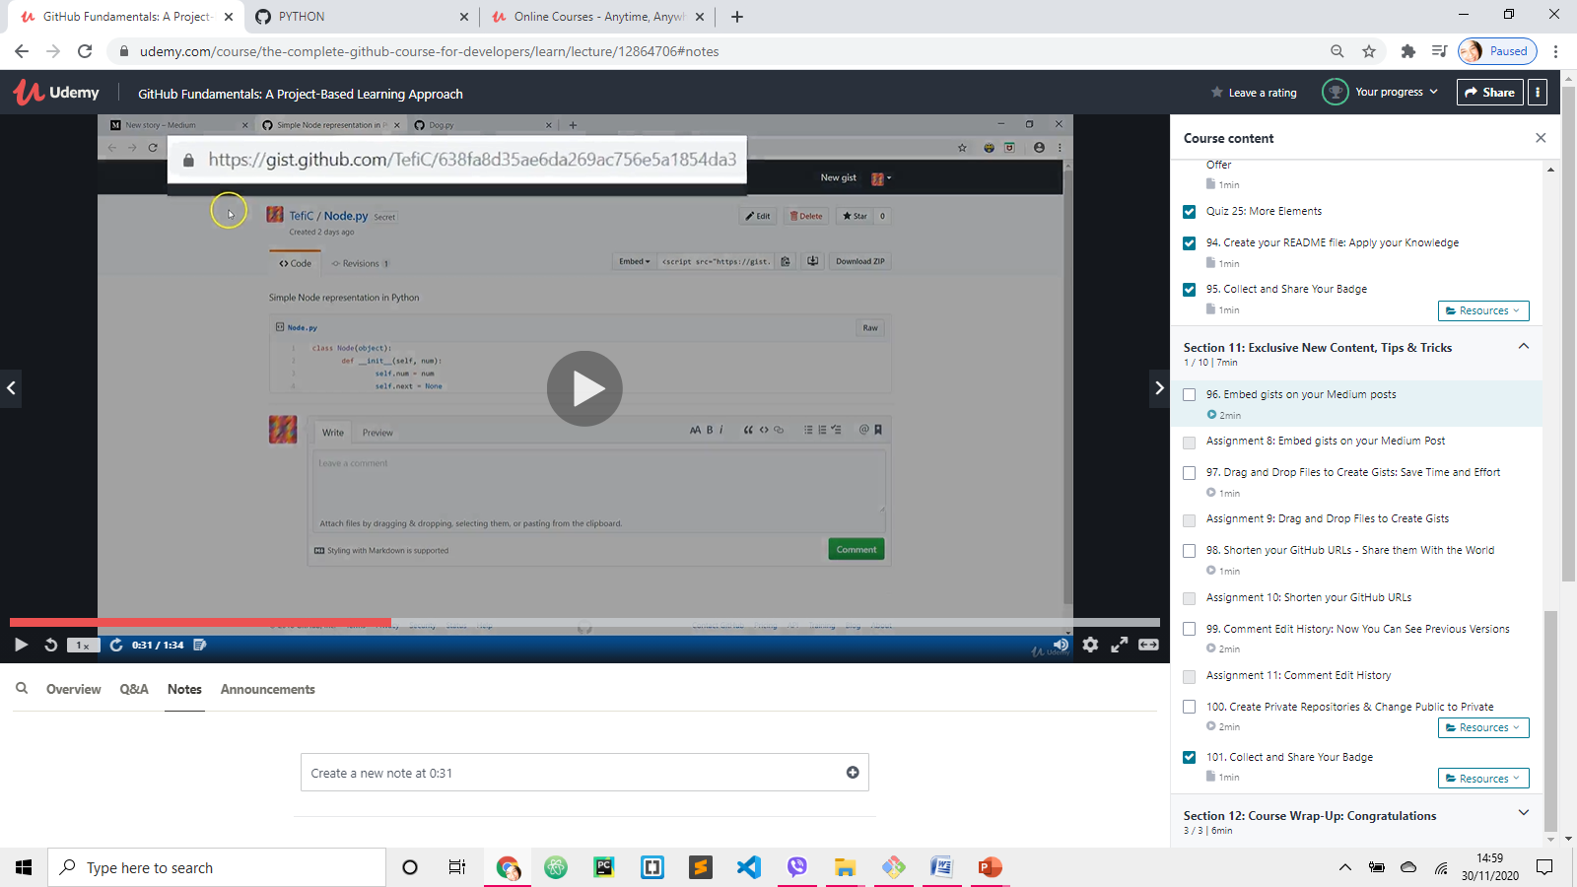
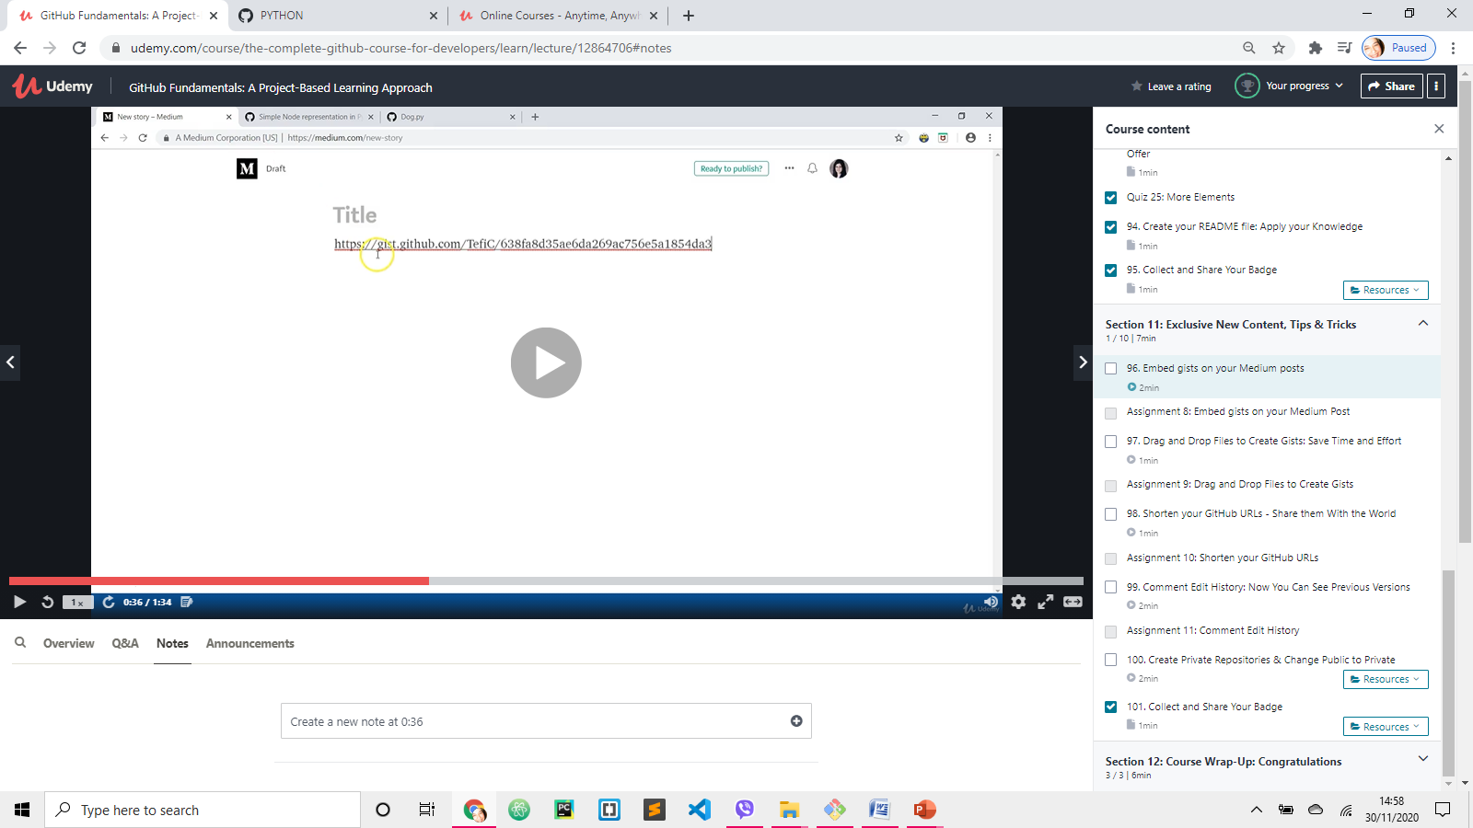
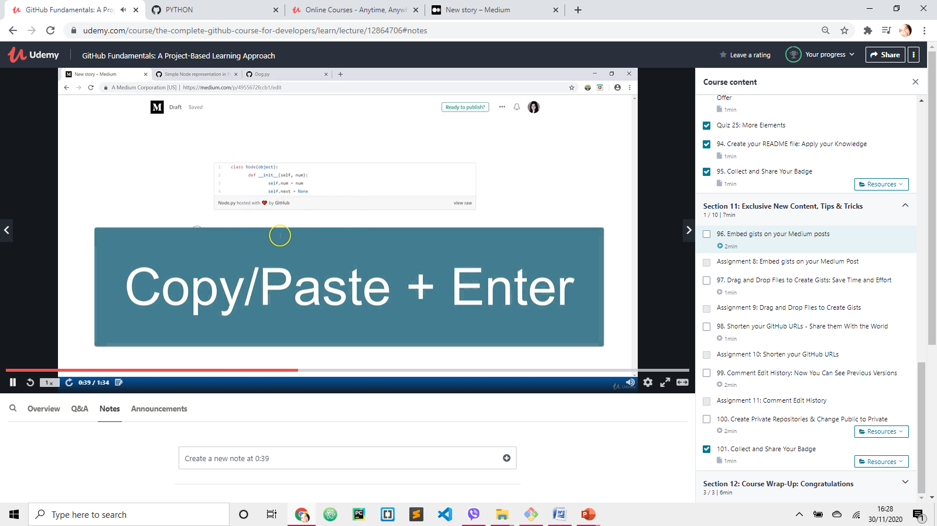
www.medium.com
Embed gist on Medium 2
1
Start writing story
2
Copy GIST link
3
Paste the link here, and press ENTER

Slide 10
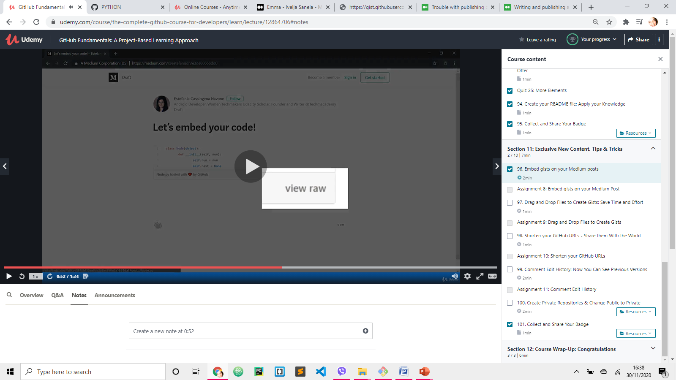
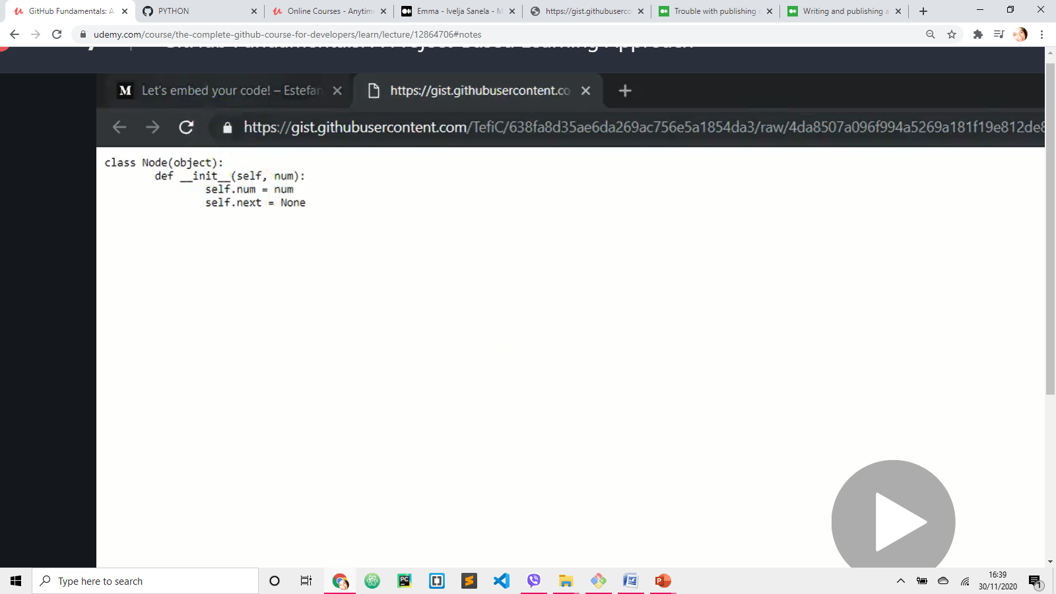
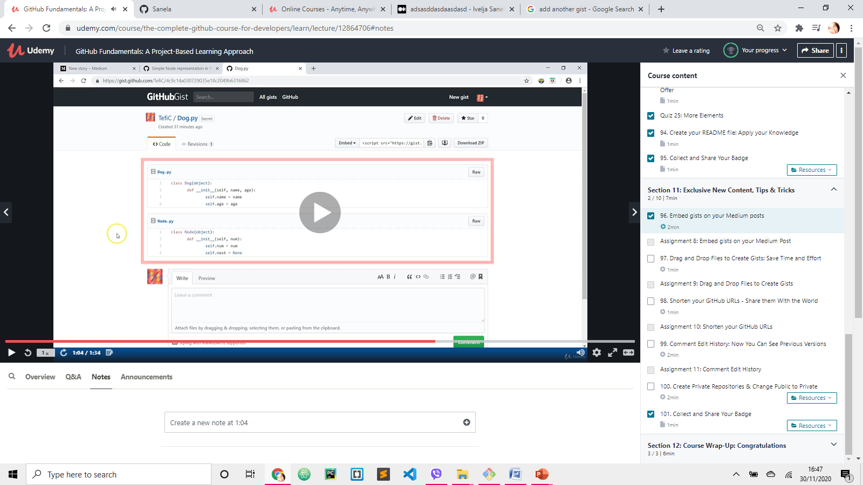
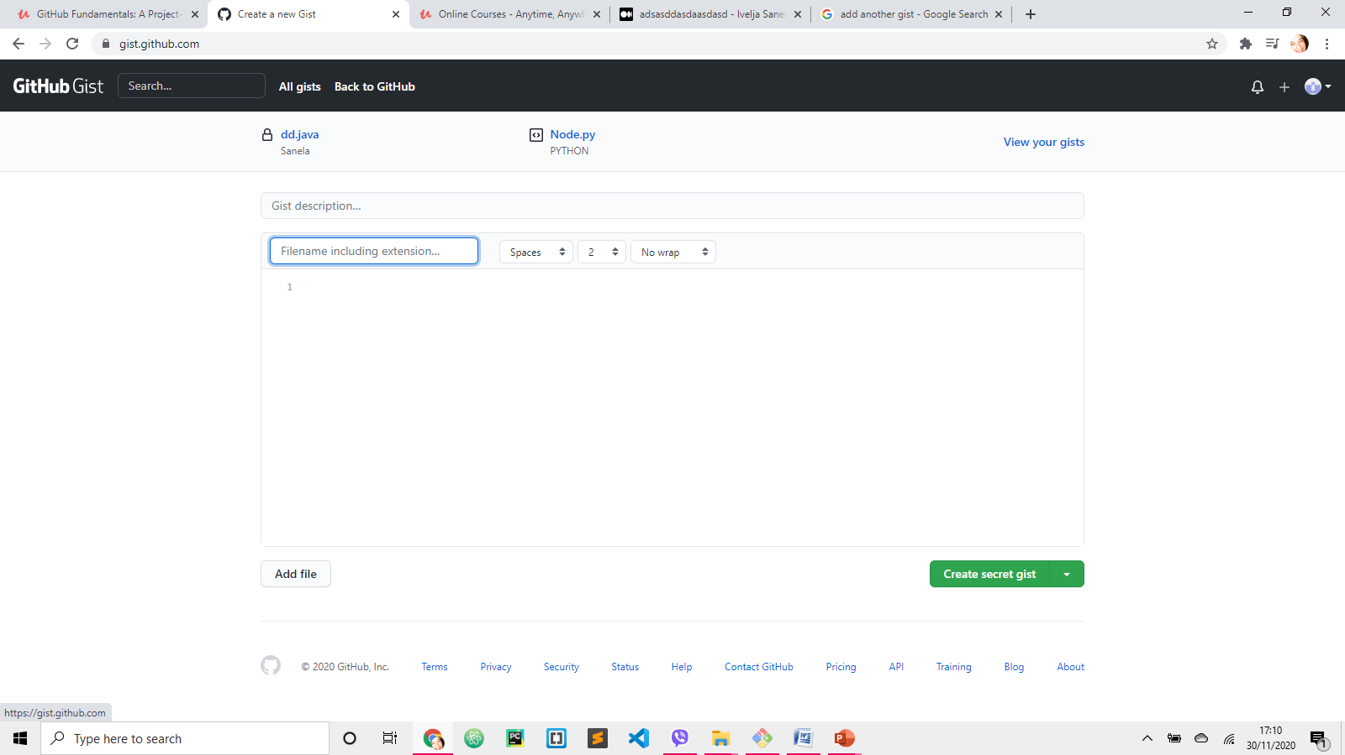
Embed gist on Medium 3
View Raw is available once the article is published
Embed gist that has multiple files
New Gist
Copy and paste the URL address
Medium will create 1 article for both files

Slide 11
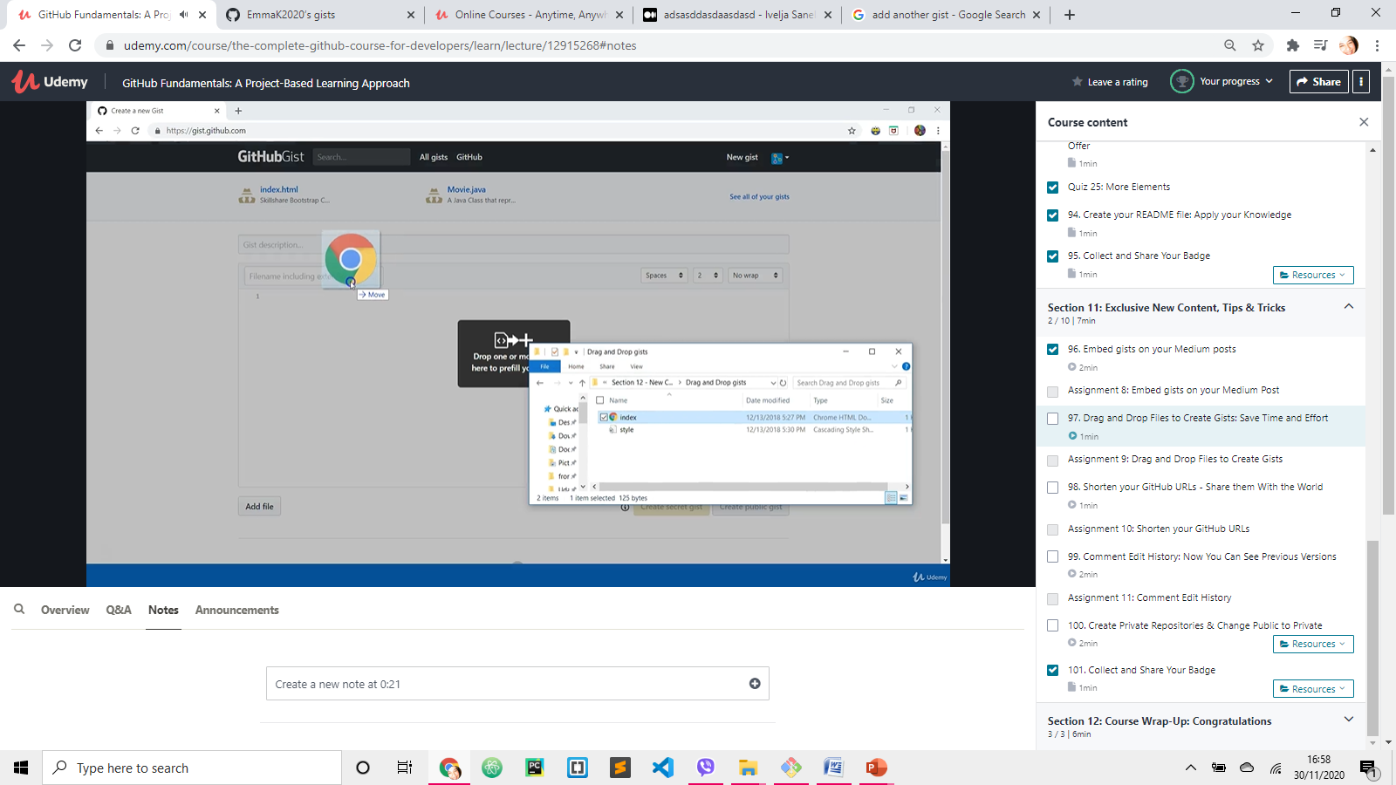
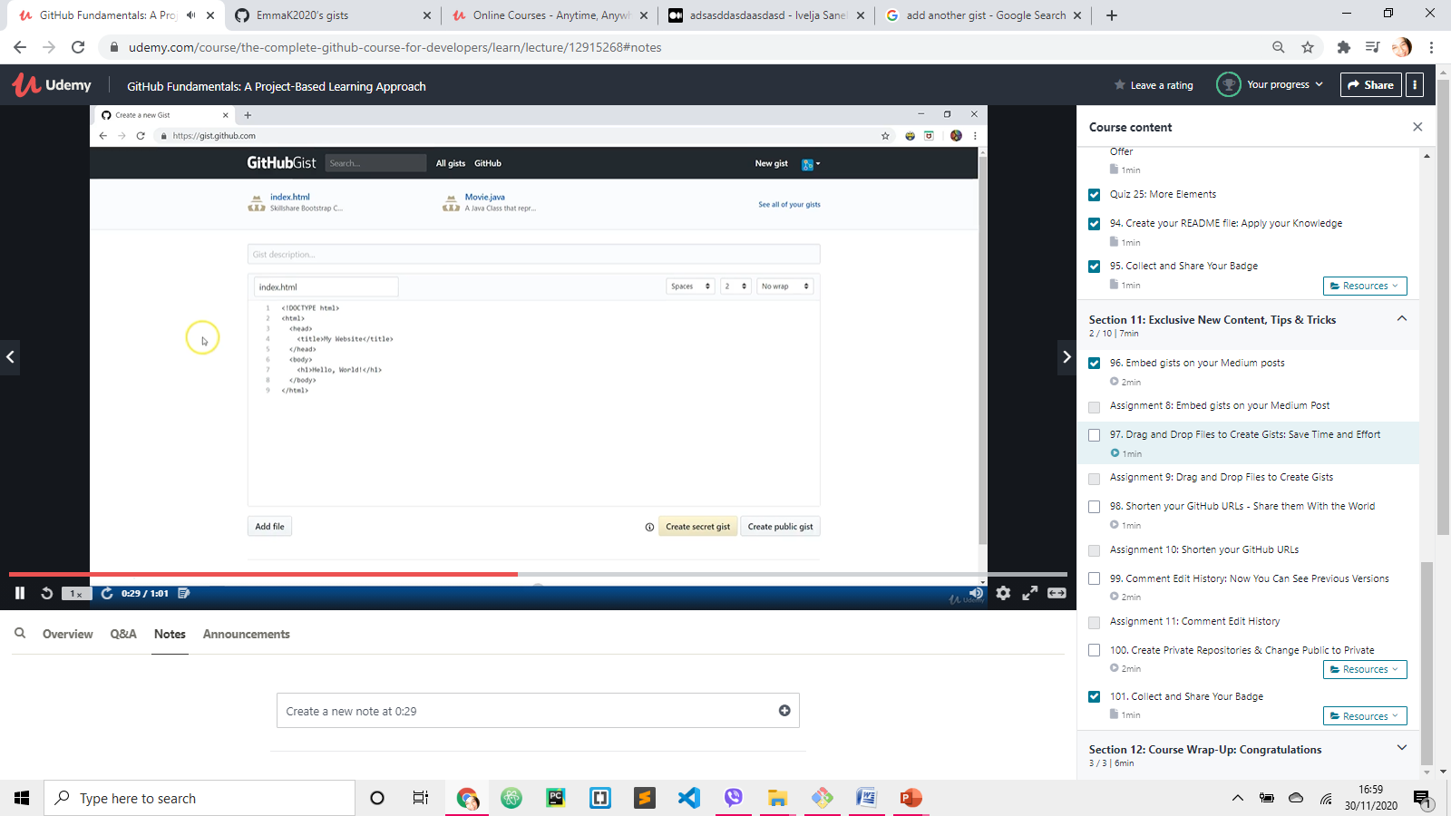
Drag and drop file to create Gist
Create a Gist. Title and content will be added.

Slide 12
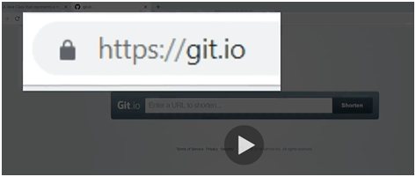
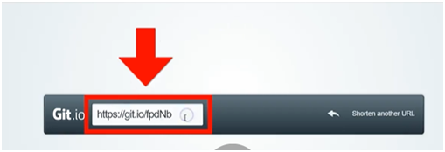
Shorten URL address
Enter URL you want to shorten
Copy GIST link
You are going to receive shorter version of the URL

